Slide 1

Implement and maintain safe, hygienic, and effective working practices.
Unit J7N7 04
Qualitas International
Name & Date :

Slide 2
Unit Overview
This standard is for professionals complying with the maintenance of effective health, safety, infection control and hygiene practices throughout your work, in accordance with the service protocol, legislative, regulatory, and organizational requirements. This standard is part of the Hair, Barbering, Trichology, Beauty, Nails, Wellbeing and Holistic and related industries NOS suites. As you work through this unit, you will be required to identify, assess and implement control methods in relation to yourself, the working environment including tools, equipment and products, the individual and area to be treated, prior to the procedure being performed. You must also be aware of and comply with first aid requirements in accordance with legislation and organizational policies and procedures.

Slide 3
The legislative and insurance requirements for obtaining medical diagnosis and referral.
All salon must have current Public Liability Insurance. Salons have a duty of care to their clients. Full consultations MUST be carried out and recorded. All necessary tests MUST be carried out and the results recorded. If the salon have any doubts as to whether the service can go ahead due to pregnancy, medical conditions or medications, the salon should refer the client to G.P, pharmacist or Trichologist.

Slide 4
The legislative, insurance and organisational requirements for taking and storing visual media of the individual’s treatment
This is a European Union (EU) law that came into effect on 25th May 2018. It governs the we can use, process and store personal data (information about identifiable, living person). The law ensures that organisations can only use personal information when they’re allowed to.
There are 7 GDPR requirements which are

Slide 5
The legislative, insurance and organisational requirements for taking and storing visual media of the individual’s treatment
Lawfulness, In order to satisfy the lawfulness aspect of this principle you must identify grounds for the processing of any personal data. There are 6 lawful basis's for processing personal data and at least one of these must be applicable when processing personal data. They are:
Consent: you have been given consent by the individual to process their personal data.
Contract: there is a contract in place with the individual and processing their personal data is necessary to fulfil this contract, or you have been instructed by the individual to process their data prior to entering into the contract.
Legal obligation: you must process the information in order to comply with the law.
Vital interests: you must process the personal data in order to protect an individuals life.
Public task: processing the personal data of an individual is a necessary component in performing a task in the public interest or for official functions of your company. This task must have a clear legal basis.
Legitimate interests: the processing of personal data is required in the legitimate interests of yours or a third parties, unless there is a reason to protect the individual, which overrides these interests.

Slide 6

Age restrictions
NO MINOR under the age of 16 YEARS OF AGE are permitted to have chemical services. They can have a Semi Permanent Colour where there is no hydrogen peroxide in use. This follows insurance guidelines and manufacturers instructions. There should always be a responsible adult with a minor when they are visiting a salon for any service.

Slide 7
The legislative requirements which sets out the rights of the individual and the professional.
The hairdressing industry is currently unregulated. There are no general licensing requirements and there is no statutory requirement for hairdressers (including barbers) to hold specified qualifications.
As much as there is no regulatory body to oversee the hairdressing / barbering industry, salon are expected to work professionally. They must have Public Liability Insurance, follow all Health and Safety legislation, provide a safe working environment for staff and clients and keep all records up to date

Slide 8
The importance to engage in, and document your continuous professional development to include, current and up-to-date information, policies, procedures and best practice guidance.
CPD is very important in the hairdresser/barbering industry. To do this you can attend workshops, seminars, shows, have educators visit your salon/ barbers. You will learn up-to date and new techniques, styles, products and equipment. When you learn new things you can pass your new skills on to colleagues, give your clients new hair styles, cuts, colours etc…
You also need to keep up to date with Health and Safety Legislation, policies and procedures and best practice guidance. This will ensure that you will have the correct knowledge when dealing with staff and client.

Slide 9
Health and safety (FIRST AID) regulations 1981
These regulations require your employer to provide adequate and appropriate equipment, facilities and personnel to enable first aid to be given to you if you are injured or become ill at work. The minimum first aid provision within a hairdressing salon is a suitably stocked first aid box and an appointed person to take charge of first aid arrangements.
CHECK IT OUT
If you want to obtain a first aid qualification, do you know where you could find an appropriate course?
Your employer should have chosen an appointed person within the salon to take charge when someone is injured or becomes ill at work (this includes calling an ambulance if necessary). The appointed person should look after the first aid equipment and ensure the first aid box is restocked at regular intervals. He or she should not give first aid unless they have been trained and hold a current first aid at work certificate. As there should be an appointed person in the workplace at all times, your employer may have chosen two people to carry out this role to ensure there is always one appointed person in the salon.

Slide 10
REPORTING OF INJURIES, DISEASES AND DANGEROUS OCCURRENCES REGULATIONS (RIDDOR) 1995
These regulations are the responsibility of your employer, but also include self-employed people. Your employer, or self-employed person must report;
A death or major injury
An over three day injury
A dangerous occurrence
A work related illness, which may include dermatitis, skin cancer and occupational asthma
All workplace accidents or incidents, however trivial they may seem at the time, should be reported to your employer. In addition, under the RIDDOR regulations, employers have a legal duty to report any workplace accidents, diseases or dangerous occurrences to the Health and Safety Executive (HSE). This information enables the HSE and local authorities to identify where and how risk arise, and to investigate any serious accidents.

Slide 11
ENVIROMENT PROTECTION ACT 1990
This Act is relevant to hairdressers, as you have to dispose of waste products, including chemicals. The part of this Act that affects you is concerned with your duty of care when disposing of waste. All salon waste should be disposed of in a manner that will not pollute the environment or cause harm to others.
Your employer’s responsibilities within this Act are to;
Dispose of all waste in a safe manner
Provide training for all employees in the safe disposal of waste
Contact product manufacturers for information regarding the safe disposal of products, including out of date stock
Your employer should have a commercial waste contract, which should include sharps.
CHECK IT OUT
What is the correct procedure for disposing of sharps?

Slide 12
REGULATION: DISTANCE SELLING REGULATIONS
The Consumer Contracts (formerly Distance Selling) regulations
On 13 June 2014 the Distance Selling Regulations were replaced with the Consumer Contracts (Information, Cancellation and Additional Charges) Regulations 2013. These apply to sales of goods or services to consumers without face-to-face contact. This includes selling by mail order, through the internet, using digital television, or by telephone, fax or text message.
Under the regulations, you must:
give customers specified 'prior information' before a sale is made
usually, give customers a right to cancel their order
confirm prior and certain other information in a durable form (eg in writing or email)
normally, fulfil your contractual obligations within 30 days unless otherwise agreed
usually, give customers a full refund up to 14 days after receiving their goods, if they change their mind

Slide 13
ELECTRICITY AT WORK REGULATIONS 1989
These regulations are concerned with ensuring safely when using electrical equipment. All employers must ensure;
All electrical equipment is properly maintained and in good working order
Regular tests are made by a qualified electrician on each piece of equipment, as appropriate
Records are kept regarding the testing of all electrical equipment and may be provided for inspection purposes if required
As an employee, it is your responsibility to remove and label any faulty equipment and then report it to the relevant person. You must also cooperate with your employer to comply with these regulations.
CHECK IT OUT
Look at the statements that outline your responsibilities within the Electricity at Work Regulations. What should you be doing to fulfil your obligations relating to this piece of legislation?

Slide 14
PERSONAL PROTECTIVE EQUIPMENT AT WORK REGULATIONS 1992
These regulations require an employer to provide their employees with protective equipment if they may be exposed to any risk to health or injury during their working hours. The risks will have been assessed during the risk assessment your employer has to carry out under related regulations. All employers have the responsibility to;
Assess the need for the use of personal protective equipment
Supply protective clothing or equipment free of charge
Train staff in the use of personal protective equipment
Ensure the equipment is properly maintained
Ensure it is fit for purpose
Personal protective equipment for you may include gloves, an apron and a facemask for asthmatics when mixing powder bleach, but not of the ‘dust free’ variety. Personal protective equipment for your clients includes a gown, towels and plastic capes. These should be used to ensure the client’s skin and clothes are protected.
BE PROFESSIONAL
It is your responsibility to look after personal protective equipment and report its loss or damage to your employer so it can be replaced.
It should be noted, however, that personal protective equipment is considered to be a last resort when implementing measures designed to reduce or control an identified risk. It is essential that other control measures be used before, or in addition to, the provision of such items.

Slide 15
CONTROL OF SUBSTANCES HAZARDOUS TO HEALTH REGULATIONS (COSHH) 2002
In the salon you will use many substances that may put your heath and risk. The COSHH regulations require all employers to assess the health risks that arise from the use of hazardous substances within the workplace and to provide the controls that will be most effective in protecting staff and members of the public. The regulations apply to substances that have been classified as corrosive, explosive, harmful, highly flammable, irritant, oxidising or toxic.
The COSHH classification symbols are shown on the next slide.

Slide 16
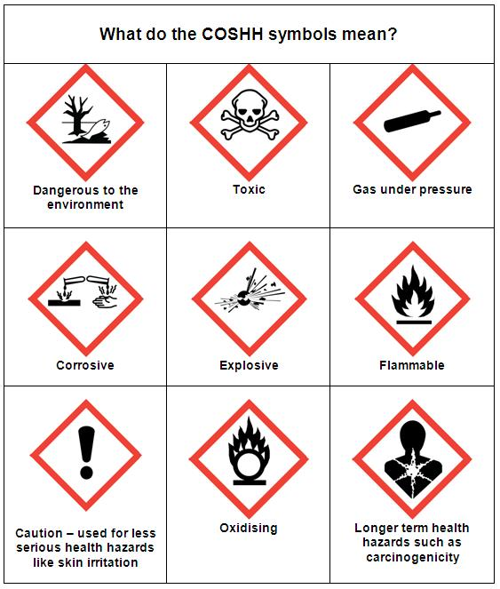
The COSHH classification symbols.

Slide 17
STORAGE OF HAZARDOUS CHEMICALS
Products that are identified as hazardous must be stored in a cool dark place, with good ventilation and away from direct sunlight. Always read the manufacturer’s instructions with regard to storing hazardous substances.
HANDLING AND USING HAZARDOUS SUBSTANCES
When using hazardous products, for example, colour, perm lotion, neutraliser or relaxing products, disposable gloves and an apron (personal protective equipment) must be worn. Some cleaning materials are classed as hazardous products and therefore gloves and an apron may be necessary. Look out for the COSHH classification symbols on the bottle or packaging and always read the labels to ensure your own safety.
Aerosols should be used away from any source of heat, especially from a lit cigarette or naked flame. Many styling and finishing products are classed as flammable substances and should not be used near any heat source.
DISPOSAL OF HAZARDOUS SUBSTANCES
Hazardous substances may cause harm to our environment and other people if they are not disposed of in the correct way. Always read the manufacturer’s instructions regarding the safe disposal of these substances. If you have any doubts, you can telephone the manufacturer and they will advise you on safe methods of disposal. Your salon may have its own policy for disposing of salon waste – ask the designated person within your salon.

Slide 18
HEALTH AND SAFETY LEGISLATION
The Health and Safety at Work Act 1974
Most health and safety law is derived from the Health and Safety at Work Act 1974. This Act requires employers to;
Provide and maintain a safe working environment
Provide adequate welfare facilities
Provide safe systems of work
Provide information, training and supervision
Ensure the safe handling, storage and transportation of goods and materials
Provide and maintain safe equipment
These requirements are also included in other regulations, some of which will be discussed later in this unit.
As an employee, you also have duties under this Act. You must;
Not endanger yourself or others by your acts or omissions
Cooperate with your employer in order for their duties to be fulfilled
Not misuse anything provided in the interests of health and safety
Report all accidents, incidents and unsafe conditions or practices
CHECK IT OUT
What welfare facilities are provided in your salon?

Slide 19
FIRE PRECAUTIONS (WORKPLACE) REGULATIONS (AMMENDMENT) 1999
Your employer is responsible for undertaking an assessment of the fire risks on the premises, to produce an emergency plan and to inform, instruct and train you about the fire precautions in your workplace. Your employer should also nominate a designated person to help them.
You also have responsibilities to ensure your own health and safety and that of your colleagues and others who may be affected by your actions.
You should cooperate with your employer so that they are able to carry out their statutory duties
You must inform your employer/health and safety representative of any situation within the workplace that you feel may constitute a risk to health and safety
You must use all equipment correctly, following the training and instruction guidance you have received
CHECK IT OUT
Ask your employer to confirm the salon’s policy relating to the use of extinguishers, as some insurance policies do not allow this.

Slide 20
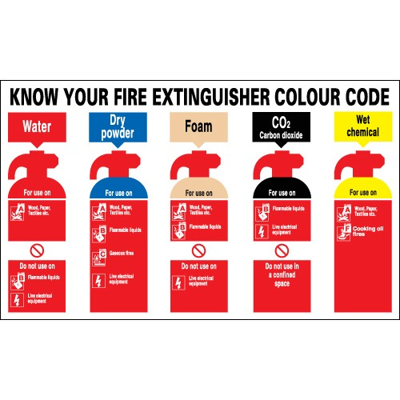

Slide 21

You have now completed the General Knowledge Part 1.
If you are happy with the answers you have provided please let your lecture know and we will now provide you with your Health and safety SOLAR test.
Initials & date of completion

