Slide 1
Meta Skills
Presentation from Qualitas in partnership with
Skills Development Scotland

Slide 2
What are Meta skills?
Skills that enable individuals to excel in the future for consideration and use by policy makers, education and skills providers and bodies, employers and anyone with an interest in skills development.

Slide 3
The skills have been classified under three headings
Self management: Manage the now
Social intelligence: Connect with the world
Innovation: Create our own change

Slide 4
Self Management : manage the now
Focusing
Sorting The ability to sort information into categories and to understand the relationship between information
Attention The ability to focus on the present and deflect/avoid distractions
Filtering The ability to filter out non-essential information and focus on the essential problem at hand
Integrity
Self awareness (reflexivity) The ability to understand and manage emotions, strengths, belief systems and limitations, and the effects of these on behavior’s and the way they impact on others
Ethics Being aware of and acting upon personal values and principles
Self control The ability to exercise control over your own impulses, emotions and desires

Slide 5
Self Management : manage the now
Adapting
Openness Being open to new ideas and approaches – having a growth mindset
Critical reflection The ability to critically reflect on new knowledge and experiences in order to gain a deeper understanding, embed and extend learning
Adaptability Flexibility when handling the unexpected, adapting to circumstances as they arise
Self-learning The ability to self educate without the guidance of others
Resilience Ability to respond positively
Initiative
Courage The ability to manage and overcome fear in order to take action
Independent thinking The ability to think for one’s self and trust one’s own judgement
Risk taking Doing something that involves danger or risk in order to achieve a goal
Decision making The act of making a considered choice after appropriately using intuition and careful thought
Self belief A feeling of trust in one’s abilities, qualities and judgement
Self motivation The ability to act without influence or encouragement from others
Responsibility The ability to follow through on commitments, be proactive and take responsibility
Enterprising Willingness to take risks, show initiative and undertake new ventures

Slide 6
Task 1: now as a group brainstorm and come up with how self – management, may come into a work environment, communicate with you assessor and he/she will write it below

Slide 7
Social intelligence: Connect with the world
Communicating
Receiving information Understanding and mentally processing verbal or written communication
Listening The ability to actively understand information provided by the speaker, and display interest in the topic discussed
Giving information Giving written or verbal communication in a way that can be best understood by those receiving the communication
Storytelling The ability to tell stories that persuade, motivate and/or inspire as well as bringing the sharing of knowledge to life through examples and illustrations
Feeling
Empathy The ability to take the perspective of others in order to understand their feelings and motivations
Social conscience A sense of responsibility and concern for wider society

Slide 8
Social intelligence: Connect with the world
Collaborating
Relationship building The ability to identify and initiate connections and to develop and maintain them in a way that is of mutual benefit to both one’s self and others
Teamworking and collaboration Working with others toward shared goals. Creating group synergy in pursuing collective goals
Social perceptiveness Being aware of others’ reactions and understanding why they react as they do
Global and cross cultural competence The ability to operate in different cultural settings
Leading
Inspiring others The ability to energise and create a sense of direction, purpose, excitement and momentum
Influencing Working to gain the agreement of others to a particular course of action
Motivating others Encouraging others to achieve goals, accomplish tasks, and complete objectives
Developing others The ability to coach and constructively review the work of others to improve and advance their skills, knowledge and performance level
Change catalyst Having the ability to ignite change

Slide 9
Task 2: now as a group brainstorm and come up with how social intelligence, may come into a work environment, communicate with you assessor and he/she will write it below

Slide 10
Innovation: Create out own change
Curiosity
Observation The ability to notice behavior or information and register it as being significant
Questioning The ability to ask questions in order to increase understanding about a subject or experience
Information sourcing The ability to filter resources and information to find information relevant to an issue or topic
Problem recognition The acknowledgement and definition of a problem
Creativity
Imagination The ability to explore ideas of things that are not in our present environment, or perhaps not even real
Idea generation Proficiency at thinking and coming up with solutions and responses beyond that which is rote or rule-based
Visualizing Translating information and thought into accessible expressions, readable and recognizable images
Maker mentality The ability to explore, through tinkering and making, in order to arrive at new ideas and solutions

Slide 11
Innovation: Create out own change
Sense making
Pattern recognition The process of classifying information into objects or classes based on key features
Holistic thinking The ability to see the big picture and understand subtle nuances of complex situations
Synthesis The process of organizing, manipulating, pruning and filtering gathered data into cohesive structures for information building
Opportunity recognition The ability to identify areas of opportunity for innovation
Analysis A systematic examination and evaluation of data or information, by breaking it into its component parts to uncover their interrelationships
Critical thinking
Deconstruction Breaking down a complex problem or system into smaller, more manageable parts before developing a new way of addressing the problem
Logical thinking The ability to identify, analyses and evaluate situations, ideas and information in order to formulate responses to problems
Judgement The act or process of forming an opinion after careful thought
Computational thinking The ability to translate vast amounts of data into abstract concepts and to understand data-based reasoning

Slide 12
Task 3 : now as a group brainstorm and come up with how innovation, may come into a work environment, communicate with you assessor and he/she will write it below

Slide 13
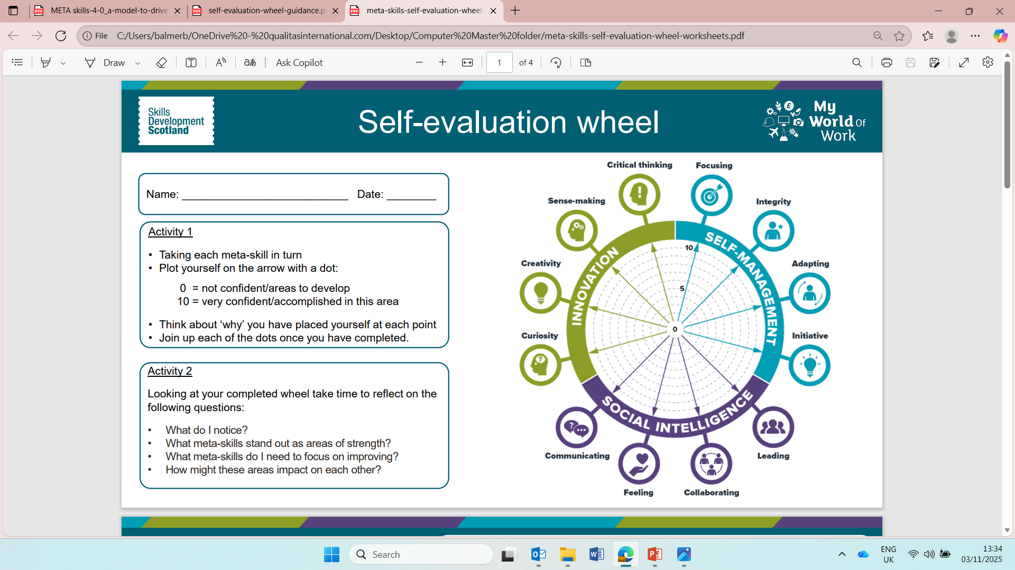
Tasks completed
We do meta skills every single day working within tour job role. Meta Skills wouldn’t work without putting these practices in place.

